Slide 1

PULMONARY HYPERTENSION
case studies ……..

Slide 2
1. PH of early onset , but long survival
IK, a male child born to consanguinous parentage, was found to have features of HF at the age of 6 m
PH ? Idiopathic ?? Sec. to AP W
RHC at MMM, at 4 yrs, adv. medical management
Did well with sildenafil upto the age of 16 yrs
Class II WHO, 6 MWT ~ 420 m, Mild central cyanosis, No JVD, PES, 2/6 short ESM, Loud P2, 2/6 HSM LLSB.
Had syncope at home while playing – CPR > ALS

Slide 3
What permitted
him to live long ?

Slide 4
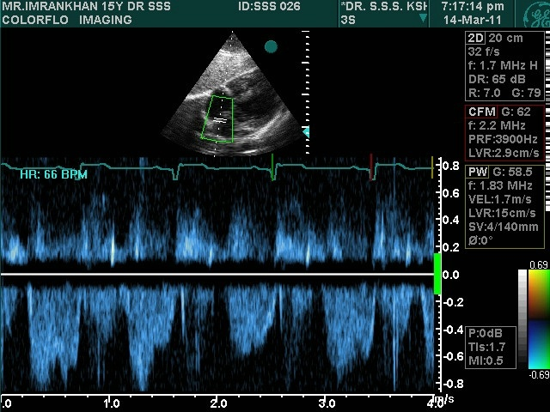

Slide 5
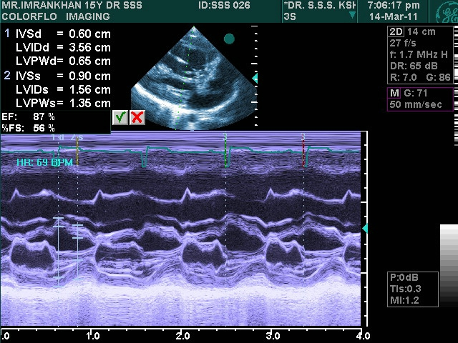

Slide 6
2. Middle aged male with DOE
43 yo male, has DOE class II for 5 yrs which
has progressed to class III for 4 months.
Few episodes of cough presysncope & blood
tinged sputum
Acyanotic, BP 134/80 mm Hg, JVP N,
S1 Normal, S 2 split wide, 4/6 ESM ULSB

Slide 7
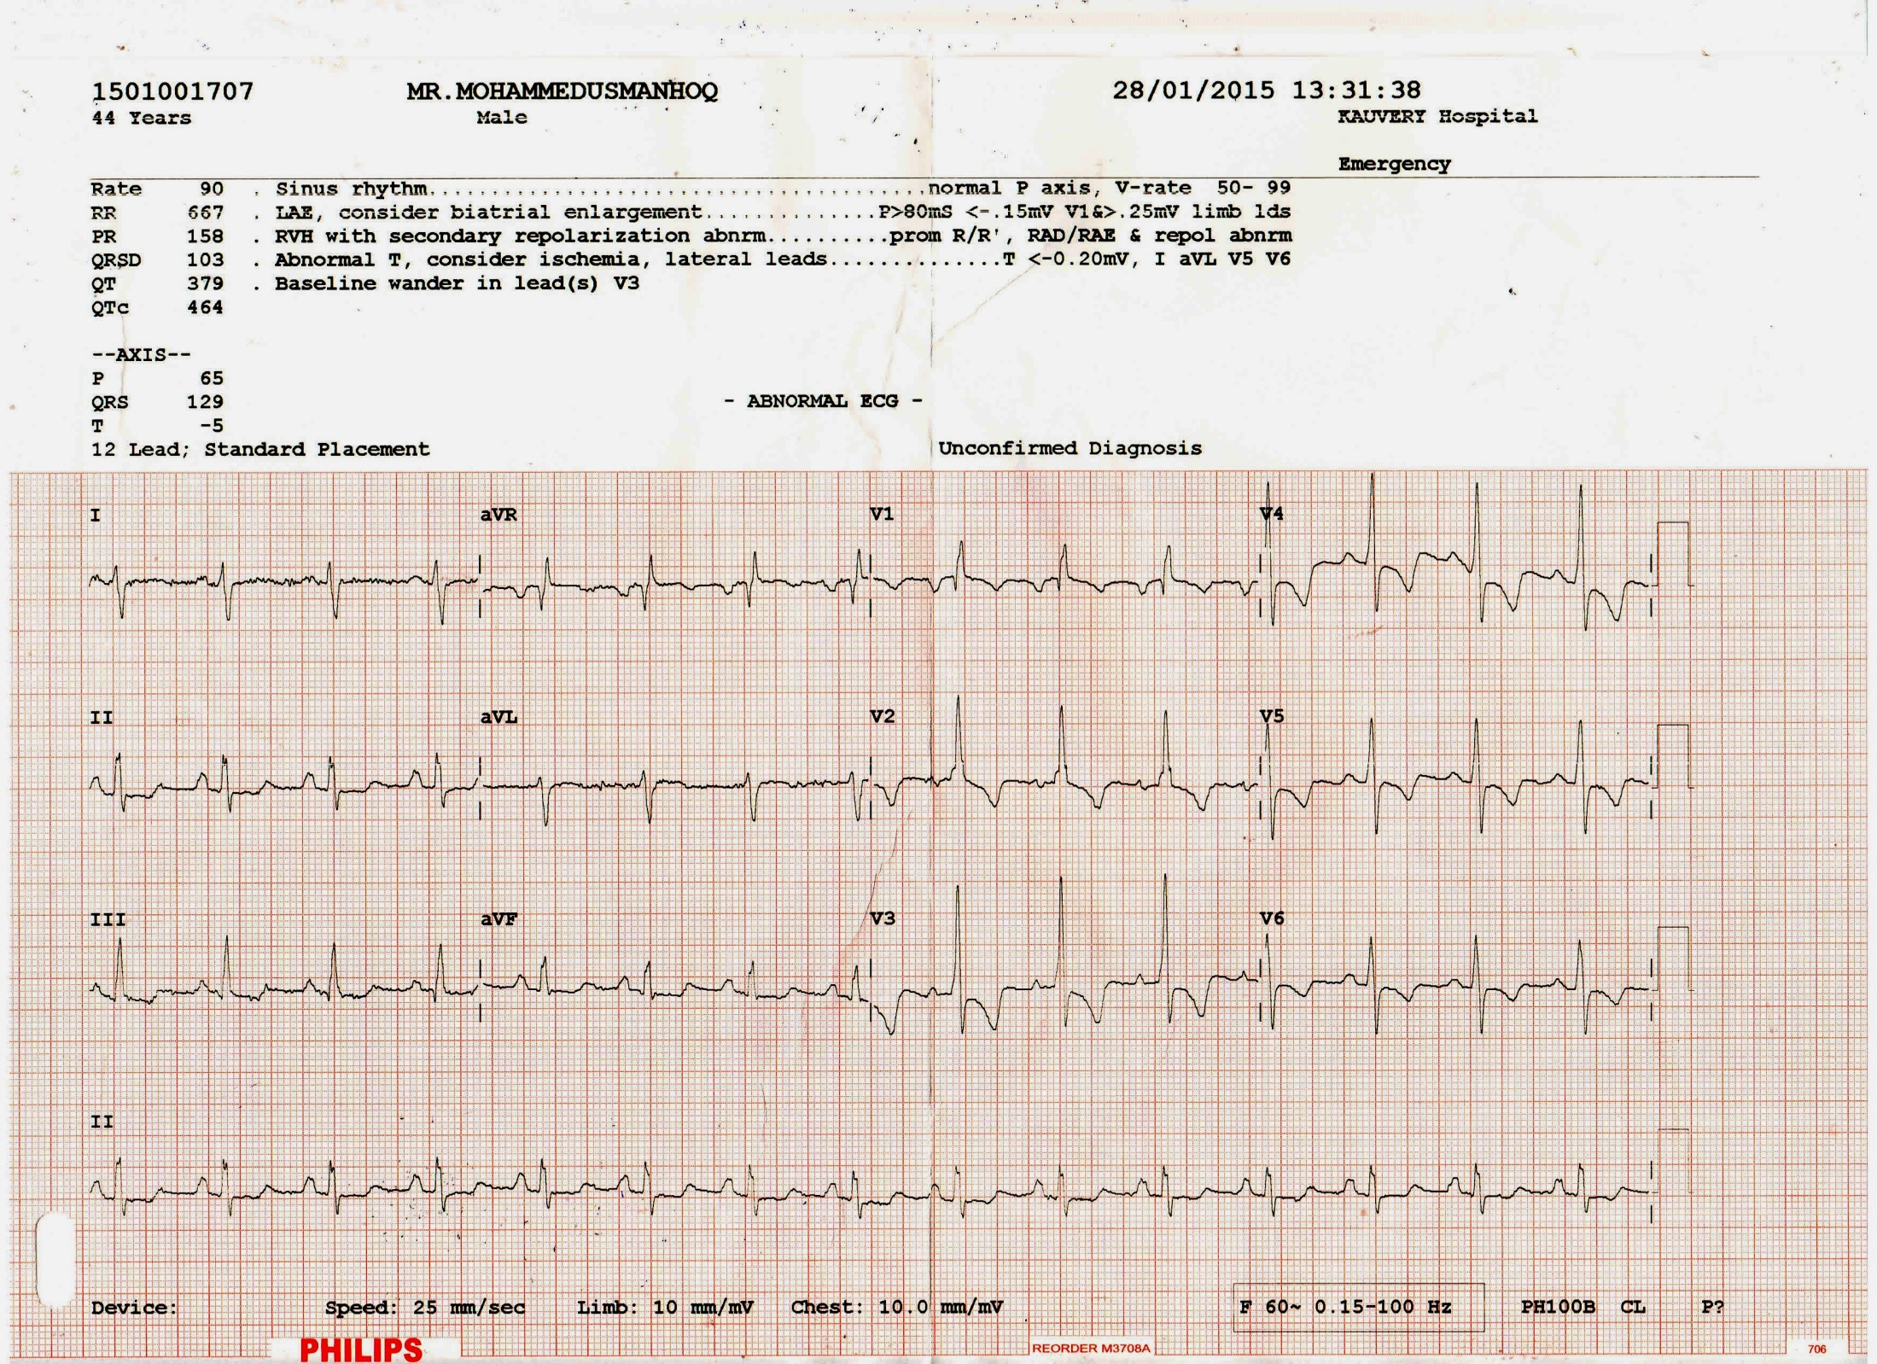

Slide 8
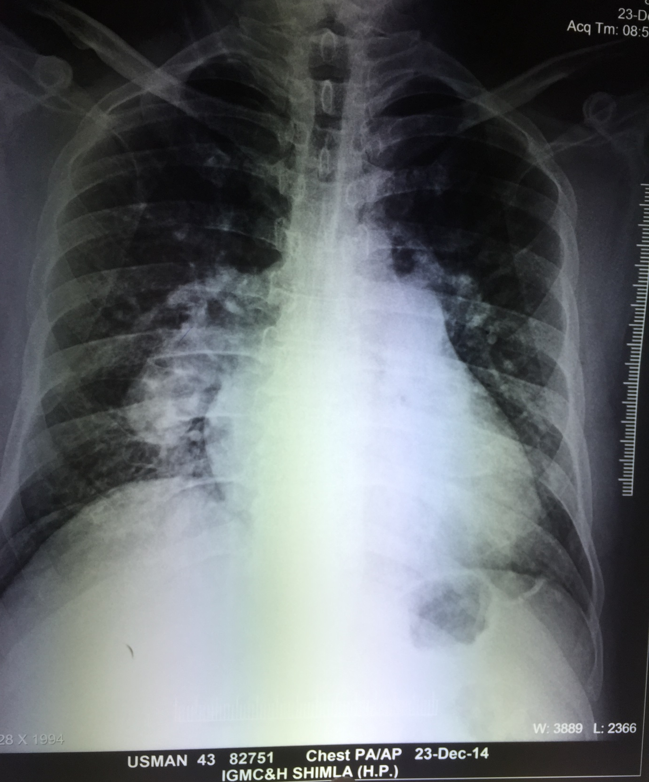

Slide 9
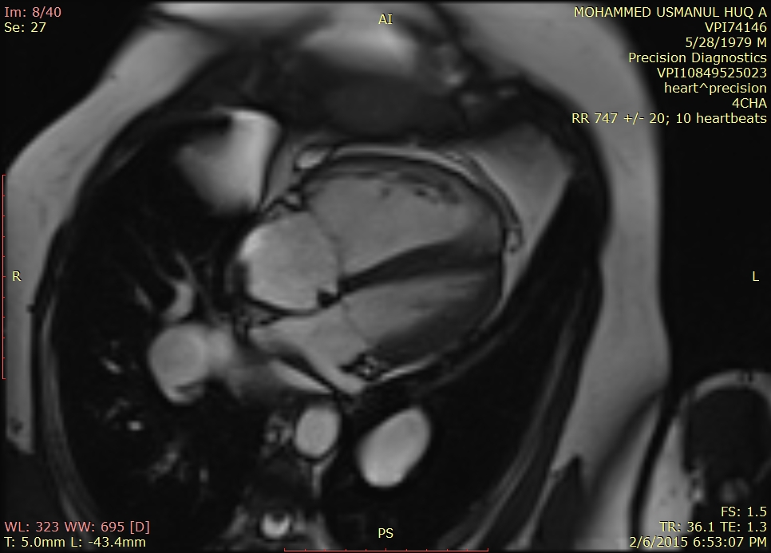

Slide 10
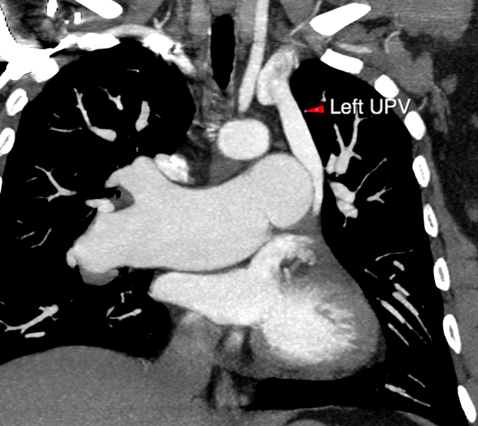

Slide 11
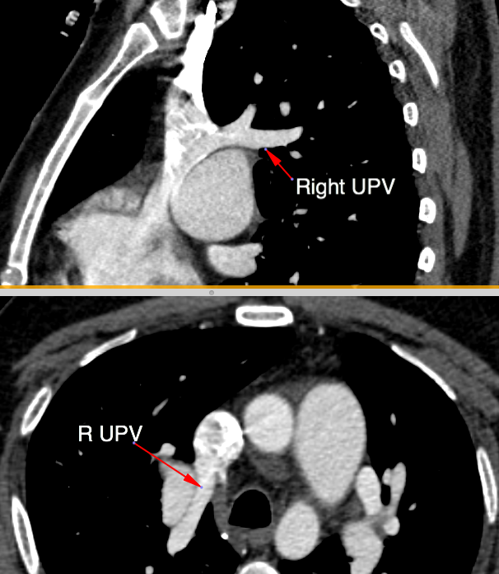

Slide 12
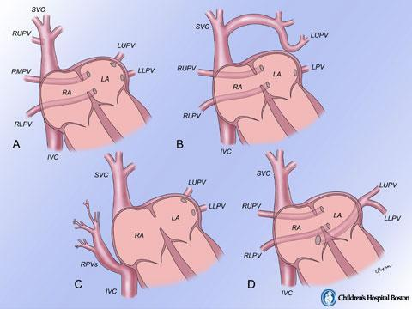
PAPVC CAUSING PULMONARY HYPERTENSION
0.4 – 0.7 % in autopsies
Isolated / With CHD
10-15 % ASD II
85 % ASD I
R PV 91%; LPV 7%; B 2%
Each PV > 25% of PBF
may be more as it drains
into lower pressure
RA / systemic veins

Slide 13
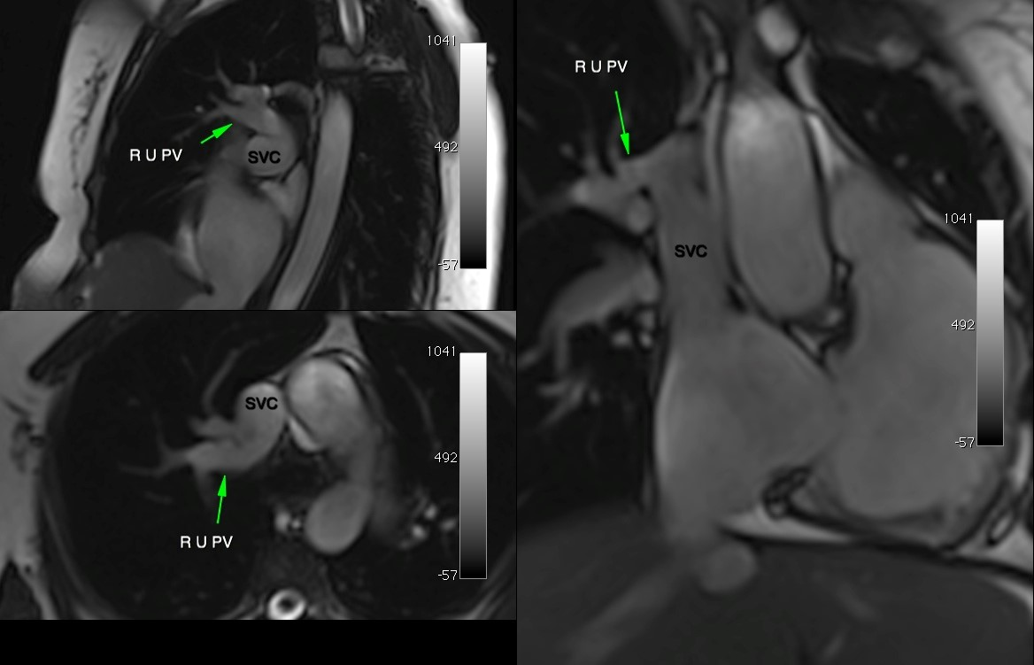

Slide 14
4. Unexplained PH with unexplained cyanosis
Mr SB, 37 yrs, teacher, presented to me with
# Dyspnea on effort class III and
# Dull constant ache over left chest for 6/12
# No PND, Orthopnea, Hemoptysis, Recurrent
respiratory infections or Syncope.
# No Rheumatic fever, CTD, Thyroid disease,
COPD, DVT,
# DOE class II for 15 yrs – did not seek
medical attention
# On Nifedipine 5 mg bid for one week

Slide 15
Tall asthenic person, not in distress, dusky nail beds ( SPO2 86%), grade 1 digital clubbing, no edema
JVP 6cm above sternal angle, prominent ‘a’
Pulse 86/mt, BP 120/88 mm Hg
RV apex V LICS in MCL, Grade 2 PS Impulse
S1 normaL, S2 closely split with loud P2.
PES and grade 2/6 ESM in left II & III ICS
Normal lungs and abdomen
6 minutes walk – 320 metres

Slide 16
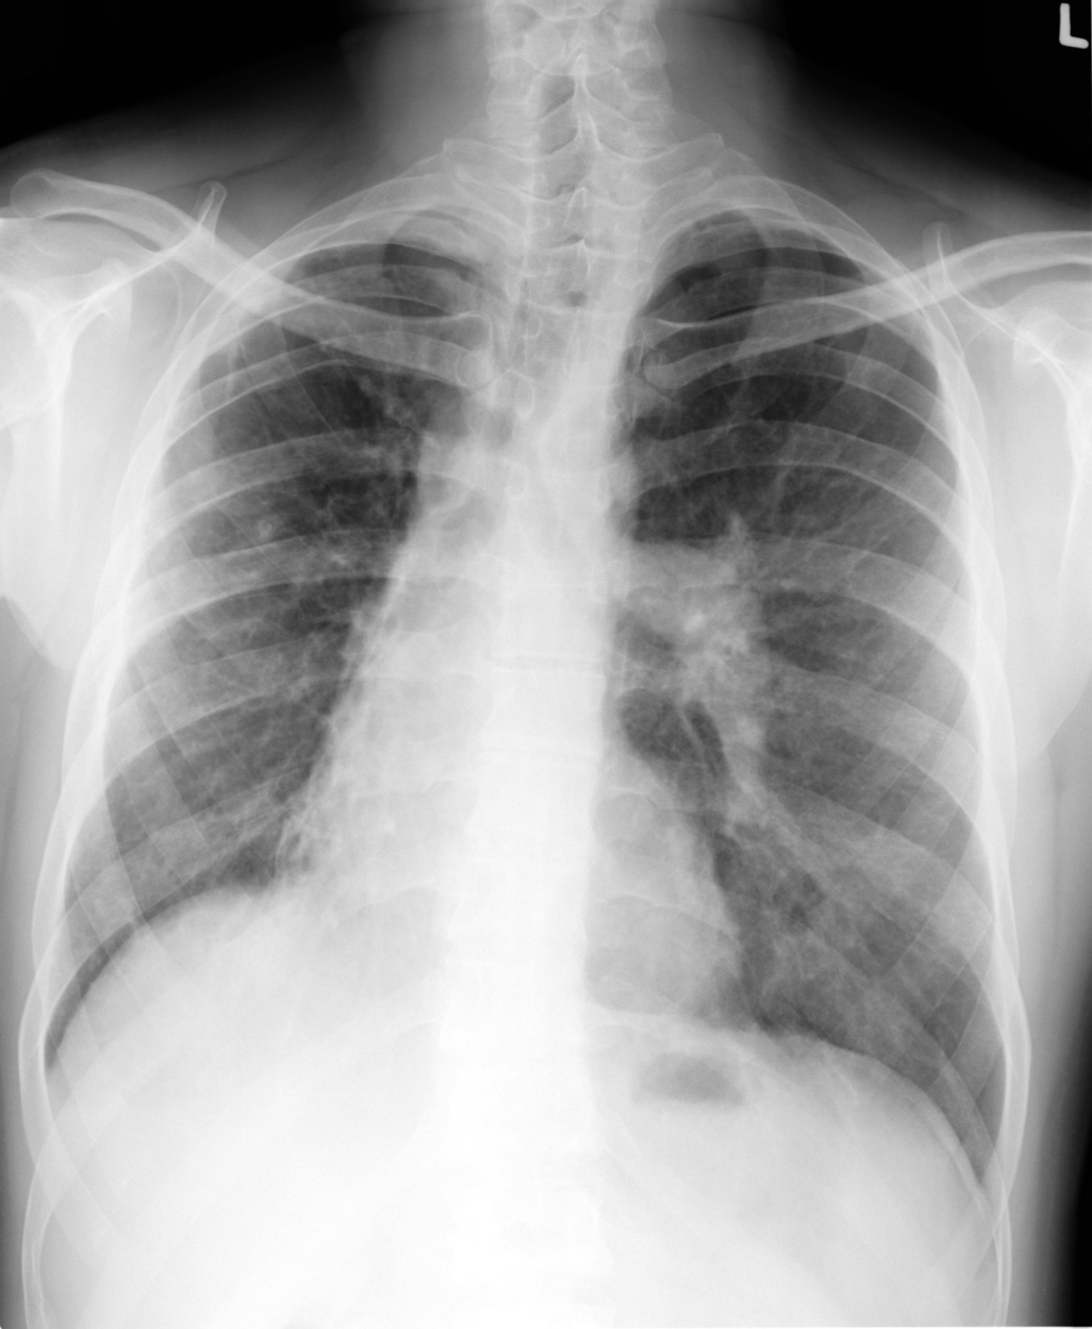

Slide 17
He was admitted and started on sildenafil 25 mg bid; within an hour he had distressing cough and became dyspneic.
Tachypneic and orthopneic, SPO2 67%.
Medium rales left hemithorax
Made quick recovery with iv frusemide 60mg and nasal oxygen.
Chest X ray was repeated……..

Slide 18
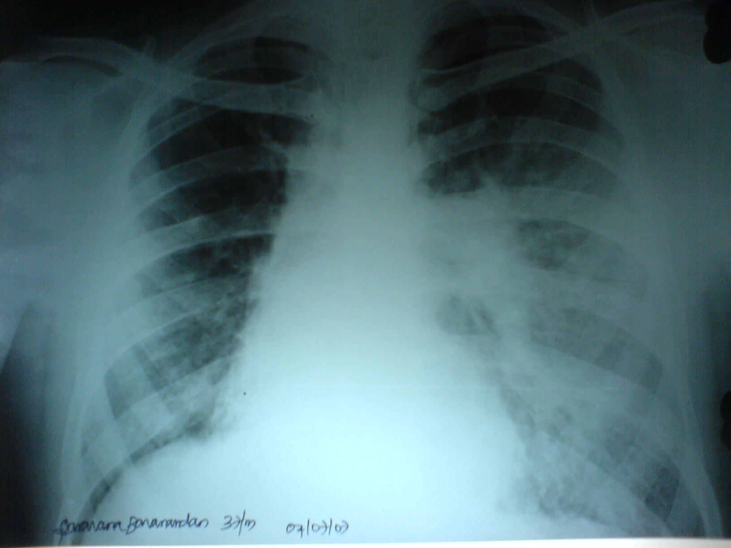

Slide 19


Slide 20
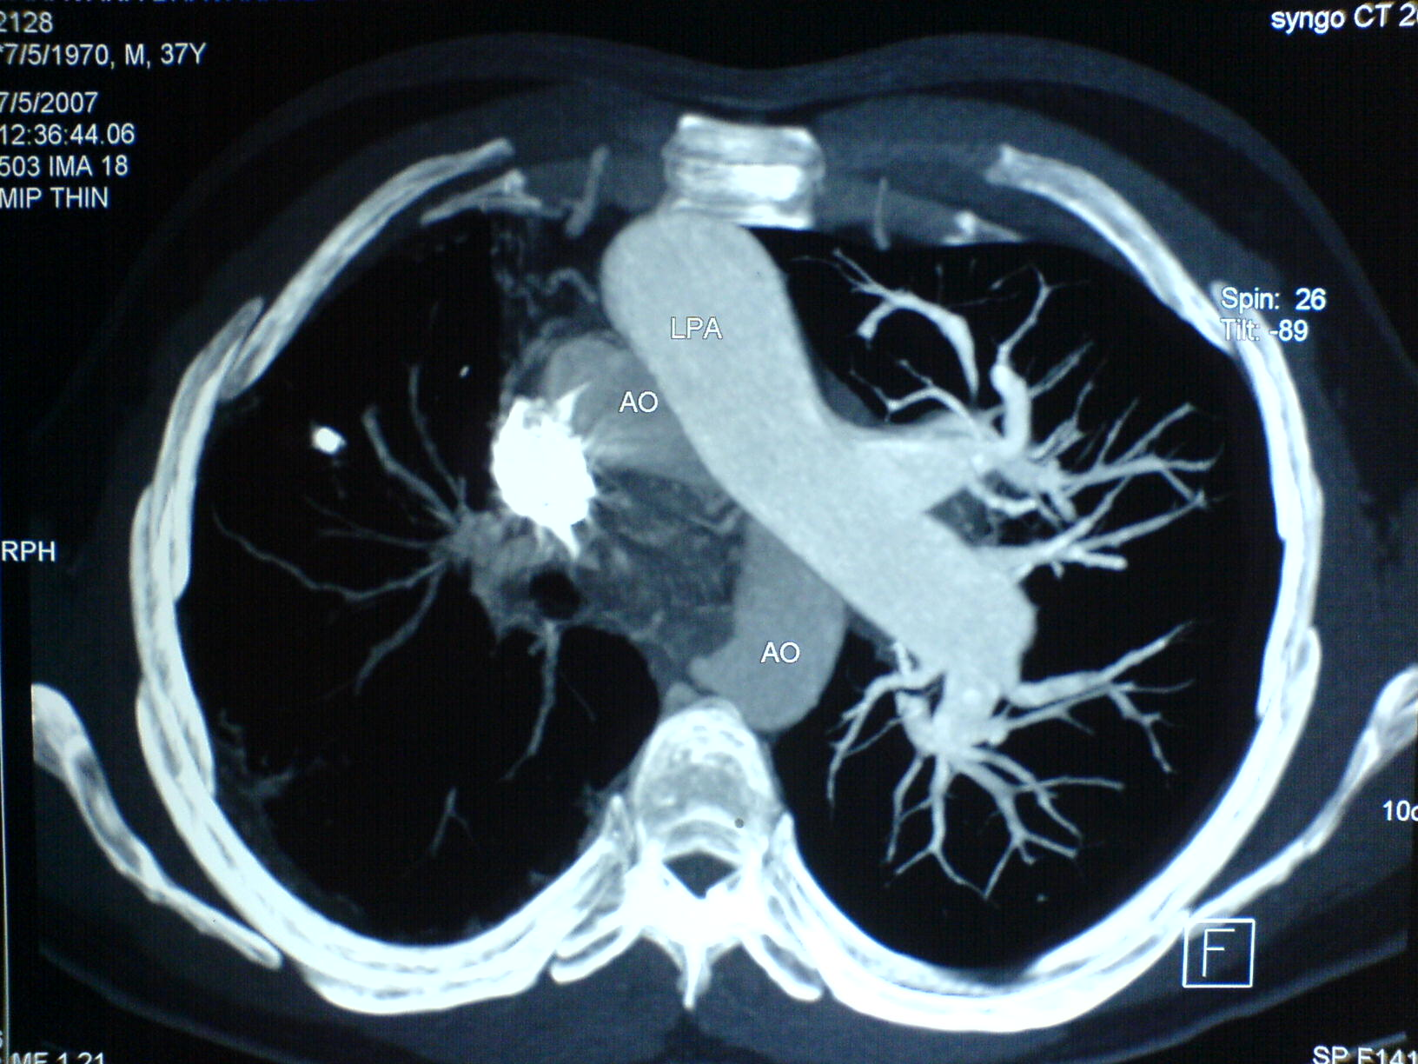
CT chest and CT PA angio was done the next day

Slide 21
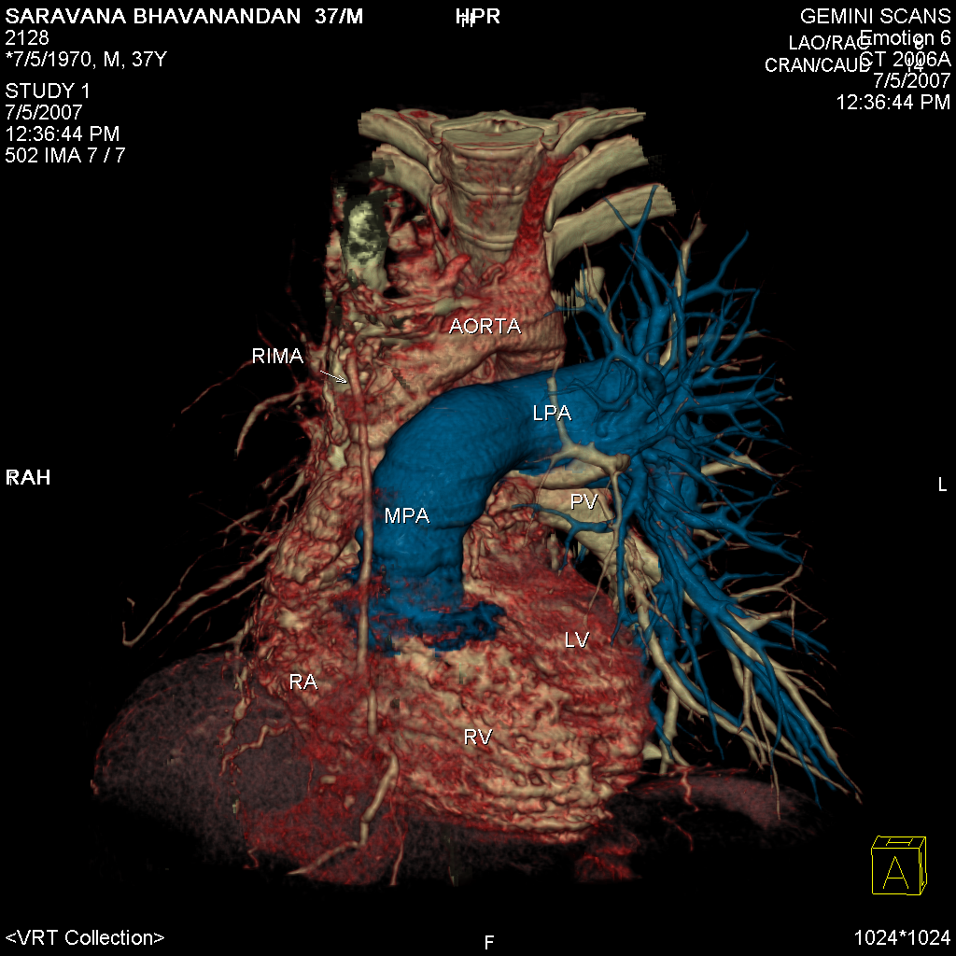

Slide 22
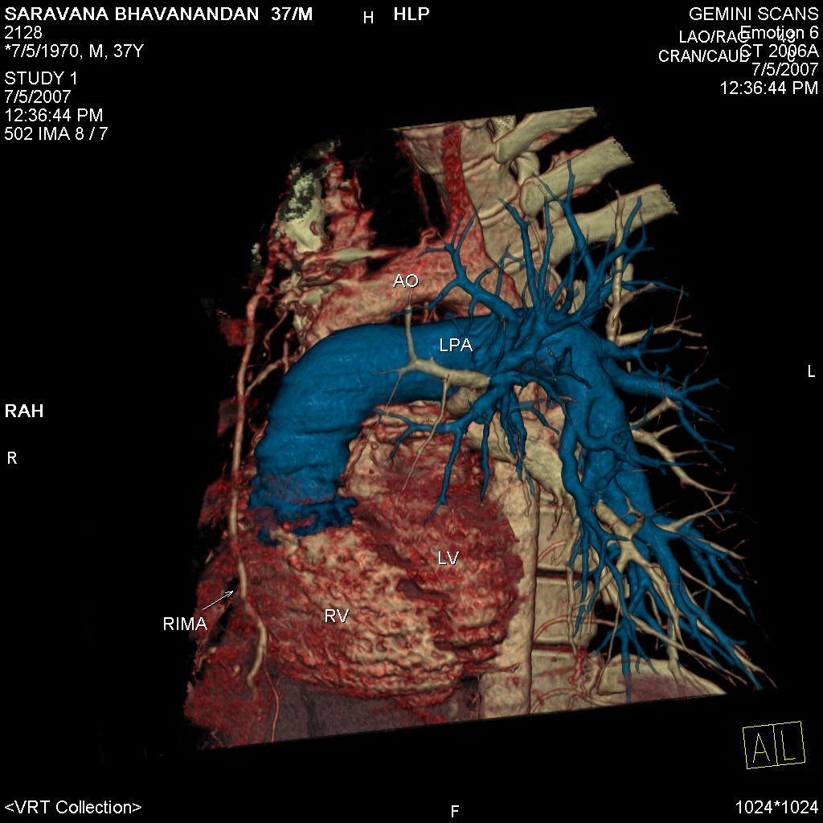

Slide 23
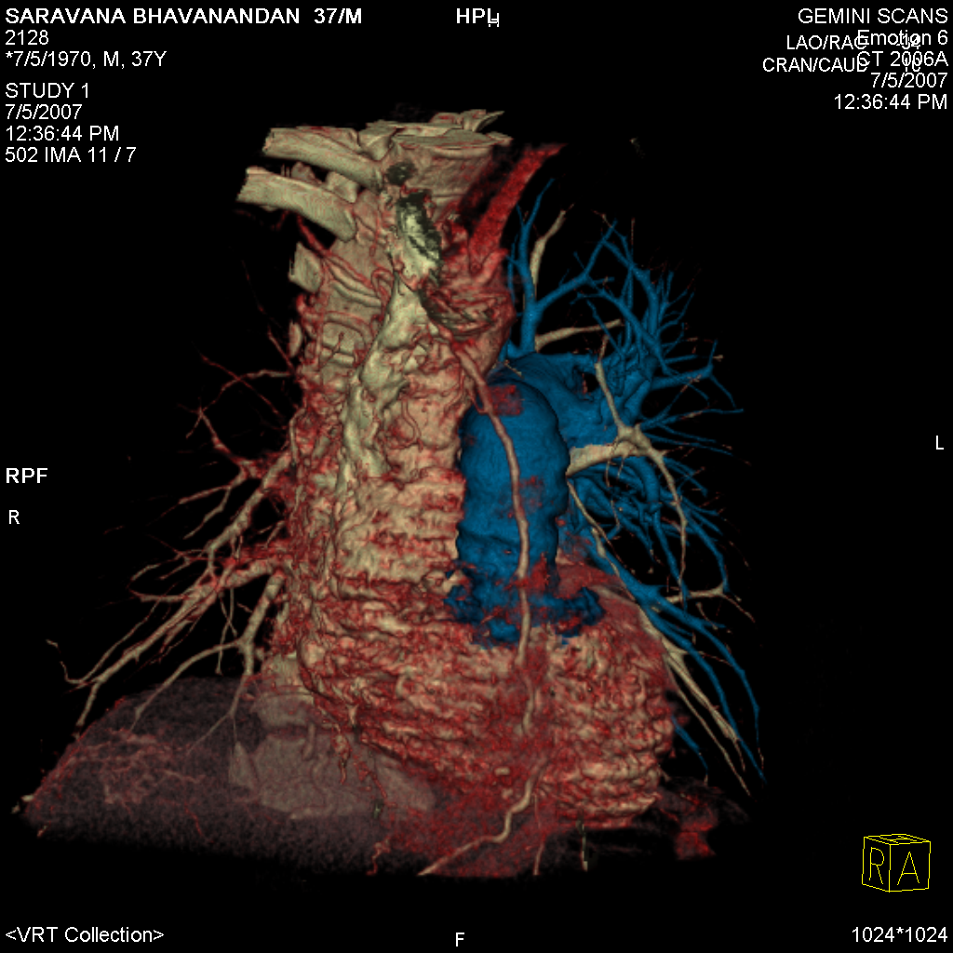

Slide 24
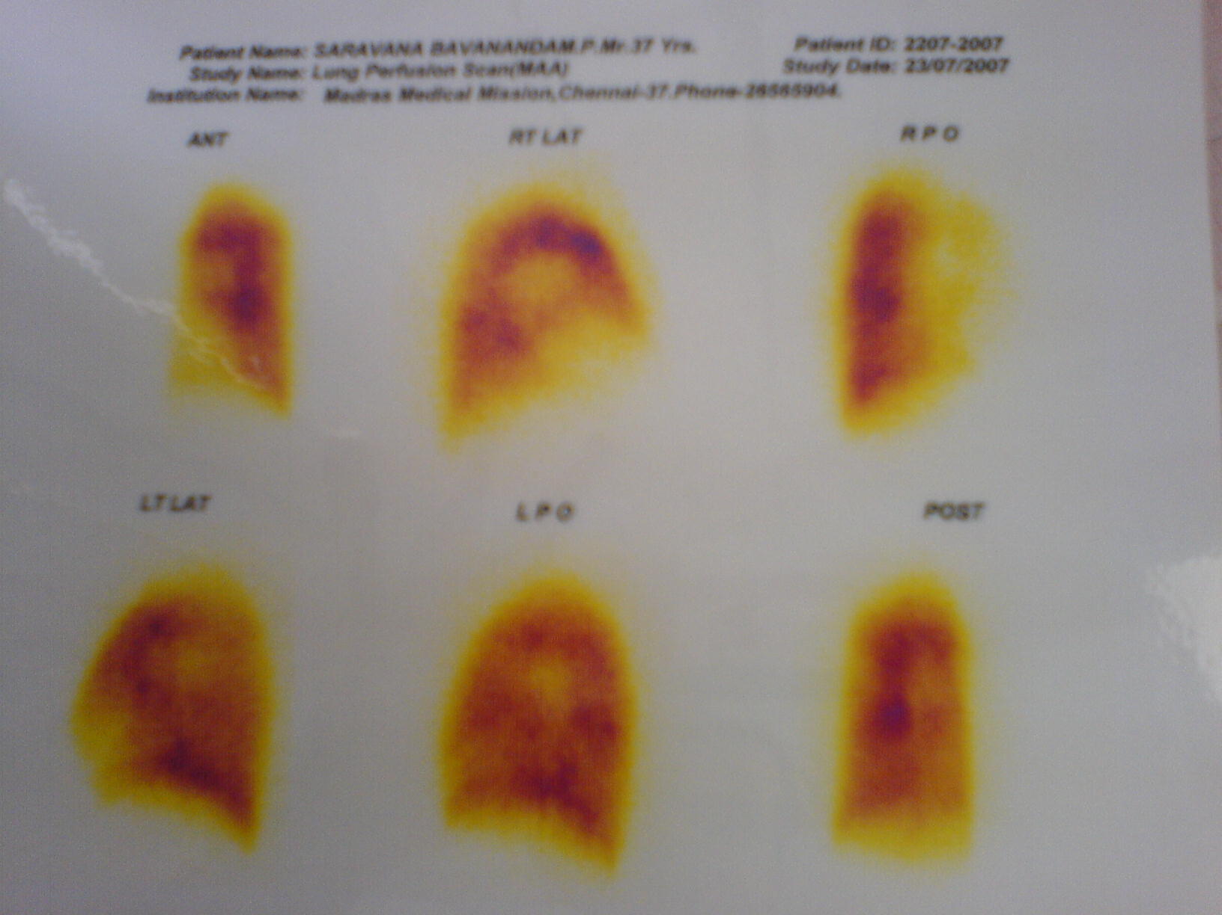

Slide 25
Subsequently he was started on sildenafil at a dose of 12.5 mg bid > 25 mg bid . Acitrom was added and an INR of 1.5 – 2.5 was targeted.
He did well and he maintained a 6MWD of 420 metres for two years.
He had class IV HF for 4 months, prior to his death, requiring at least 3 hospitaizations for worsening RV failure. Dobutamine infusion had helped in stabilizing him in each situation.

Slide 26
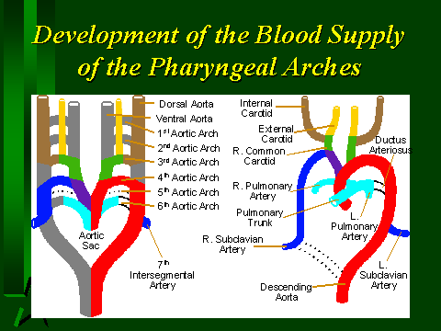
Aortic Arch Development

Slide 27
Unilateral Agenesis of PA
0.3 % in general population
Associated with – TOF, Right Aortic Arch, Truncus Arteriosus, Septal defects, PDA, Coarctation of Aorta, Supravalvar AS, Scimitar syndrome & TGA
Symptoms are due to accompanying defects
Diagnosis gets established in early childhood
Commonly the LPA is absent
Agenesis affects the PA opposite to aortic arch
Isolated : Uncommon
Usually affects RPA (2/3)

Slide 28
Pathophysiology & Presentation
Extrapleural PAs underdeveloped or absent
Intrapulmonary branches are present – their size
depends on collateral flow (bronchial, Abd.Ao
branches & coronary arteries) & vasoconstriction
due to alveolar hypoxia.
O2 exchange on the affected side is negligible
LV volume overload is unusual despite collaterals
PA pressure is normal or mildly elevated with further rise with exercise
Small percentage of patients develop severe PAH

Slide 29
Pathophysiology & Presentation
Majority remain asymptomatic – abnormal CXR
Recurrent respiratory infections, Hemoptysis
Cyanosis due to widened Alveolo-Arterial O2 gr
DOE - ↑ physiological dead space / PAH
↑ ventilation not matched by ↑ perfusion
Pooled data by Harkel ( Chest 2002 )
median age 14 yrs, No symptoms 13%
Frequent RI 37%, Dyspnea 40%, Hemoptysis 20%
PAH in 44%

Slide 30
Pulmonary Edema after Sildenafil
Overperfusion as a result of dilatation
of PAs, akin to unilateral pulmonary
edema reported in patients with
UPAA after ascent to high altitudes or
Reperfusion pulmonary edema that
occurs after thrombo endarterectomy
for CTPH

Slide 31
5. The lady with spells of dyspnea
K.78 yo female, with DM, SHT, CKD, mild CAD & asthma
had undergone VVI pacemaker implantation 2 y ago
for symptomatic 3⁰ AVB
For nearly 2 months, she had spells of shortness of
breath lasting for hours - mostly at rest; No wheeze
or desaturation whenever she visited emergency
Physical Examination revealed normal cardiac findings
CXR CTR 55%; ECG showed IIIº AVB with RV apical pacing
During her last visit, 2/6 HSM was heard over the apex

Slide 32
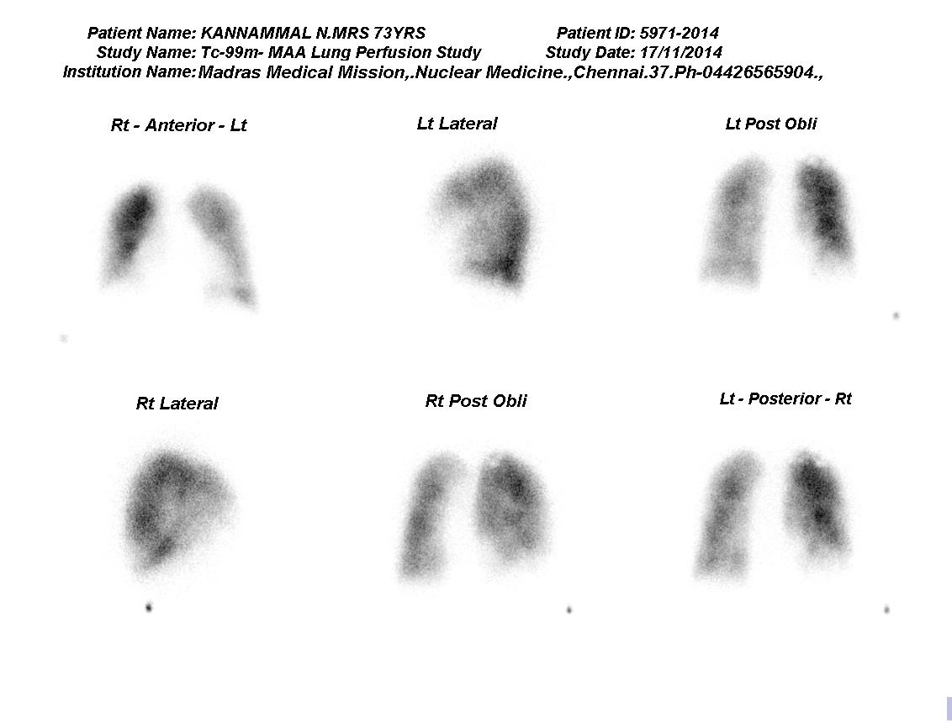
Blood cultures were negative
Lung perfusion scan resolving pulmonary emboli

Slide 33
Device related TR – a new disease
Impinging of leads on the leaflets
Injury to the leaflets / chordal apparatus
Infection of the lead with IE of TV
Thromboembolic PH

Slide 34
3D TTE to identify mechanism of TR caused by device leads
Mediratta A JACC imaging 2014; 7:337

Slide 35
6. A middle aged male with DOE & syncope
50 yo male, a S.O with no past medical illnesses
DOE class III of 3 weeks duration
Evaluated at VHF – CT PA done ; CTPH ruled out
Was prescribed Ambrisentan 5 mg od
Noticed pedal edema and he discontinued the drug
O/E Anemia + Edema + JVP N, P2 loud. No murmur
Blood check revealed anemia – Hb 6.4 g%

Slide 36
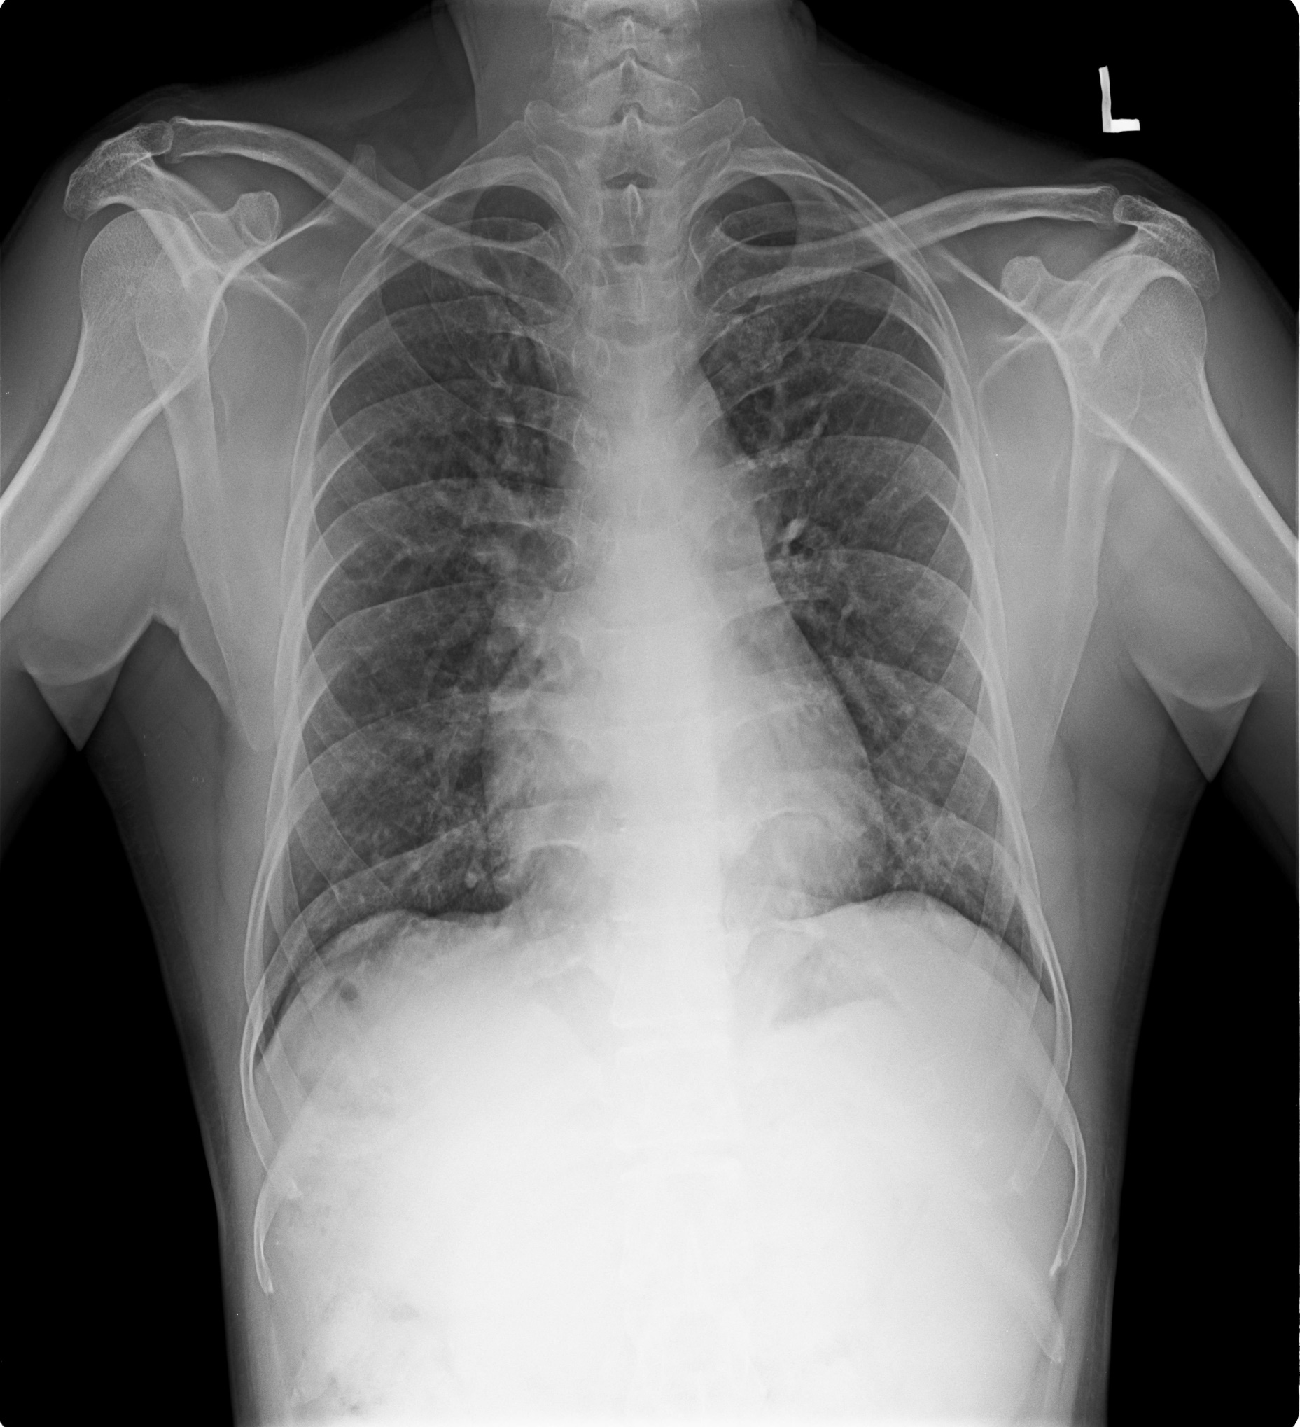

Slide 37
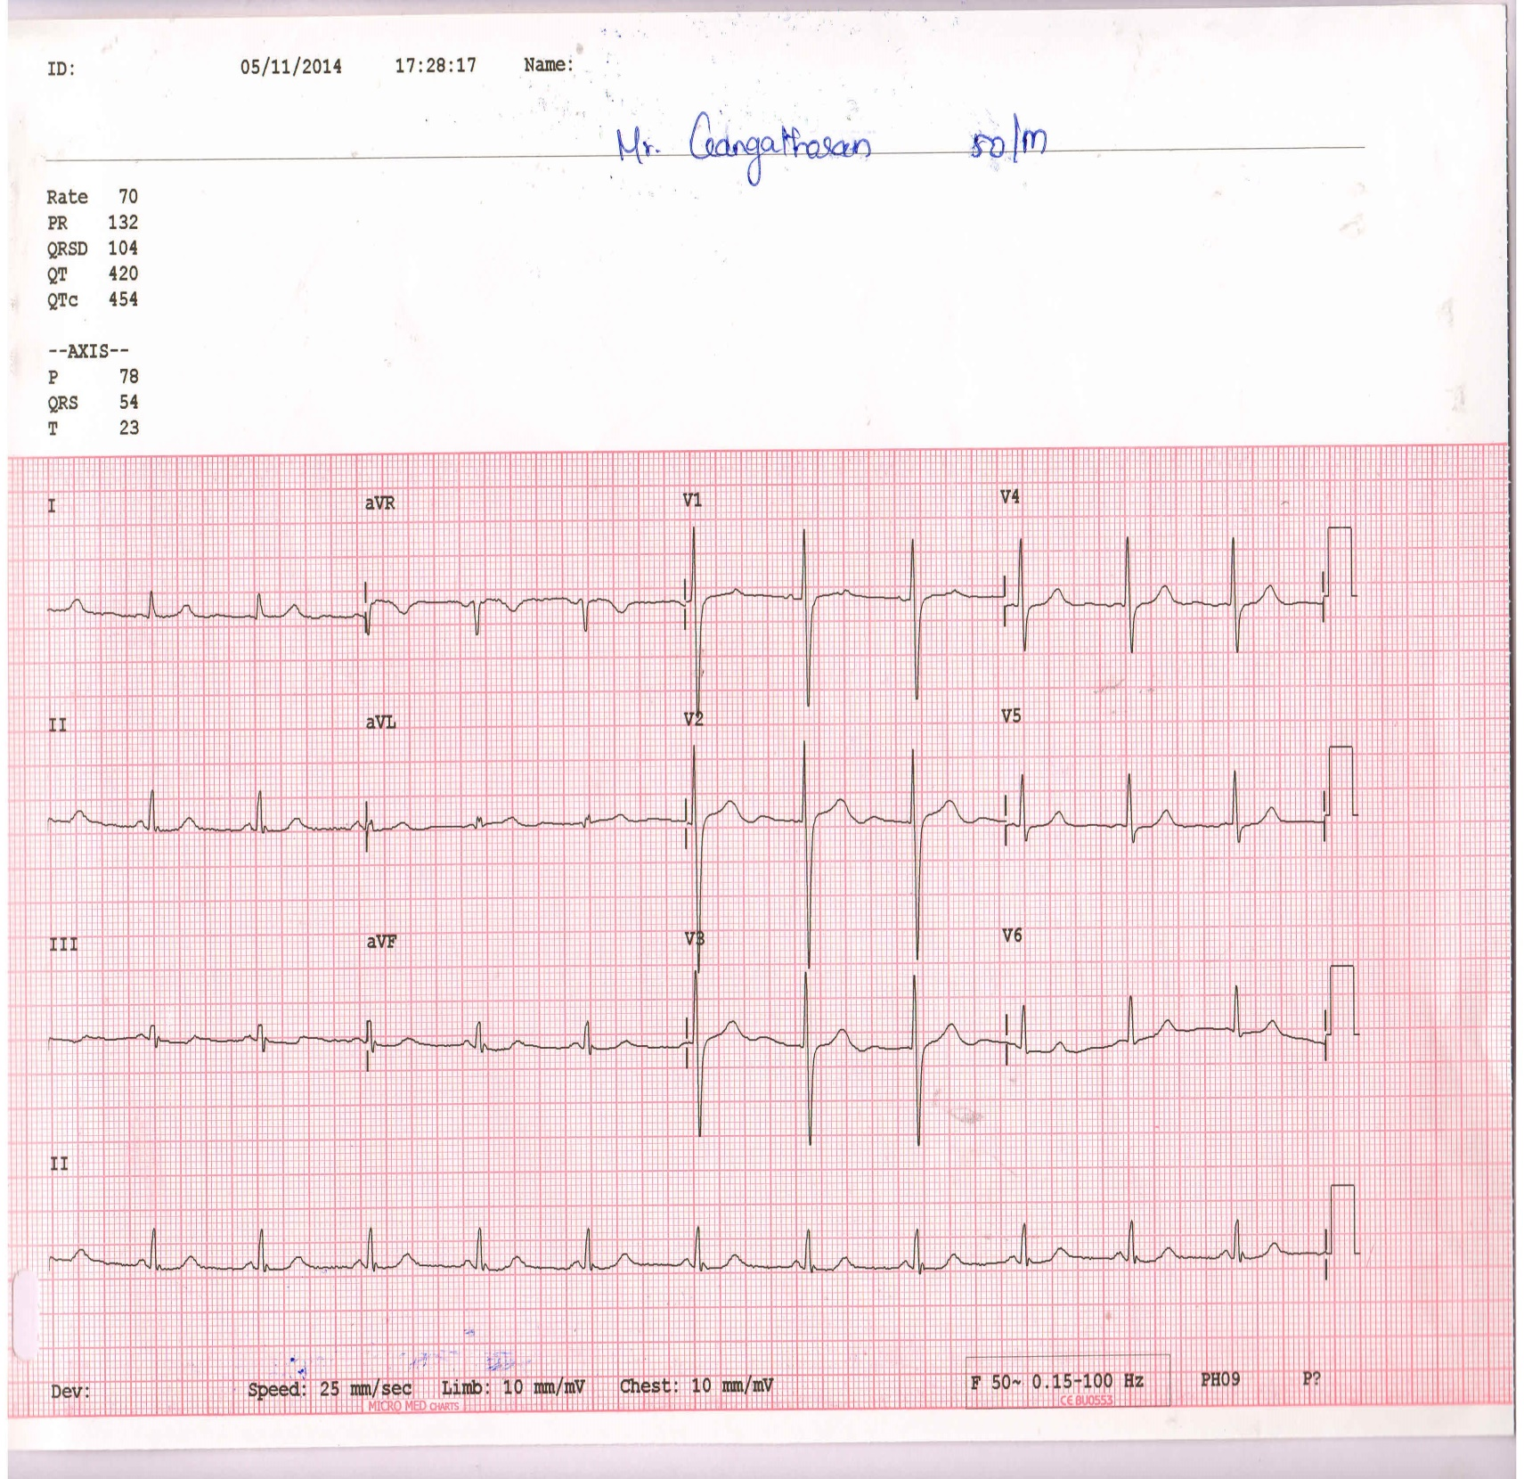

Slide 38
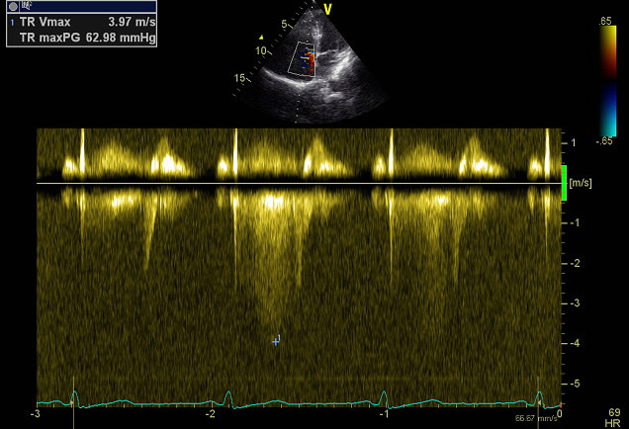

Slide 39
Not likely to be IPAH …
But, what is it ?
A male of 50 yrs
Class III dyspnea of rapid onset
A normal CXR, Near normal ECG
ECHO : Right heart chambers normal
Severe anemia – ref to hematologist
Hemolytic anemia, Sickle cell disease

Slide 40
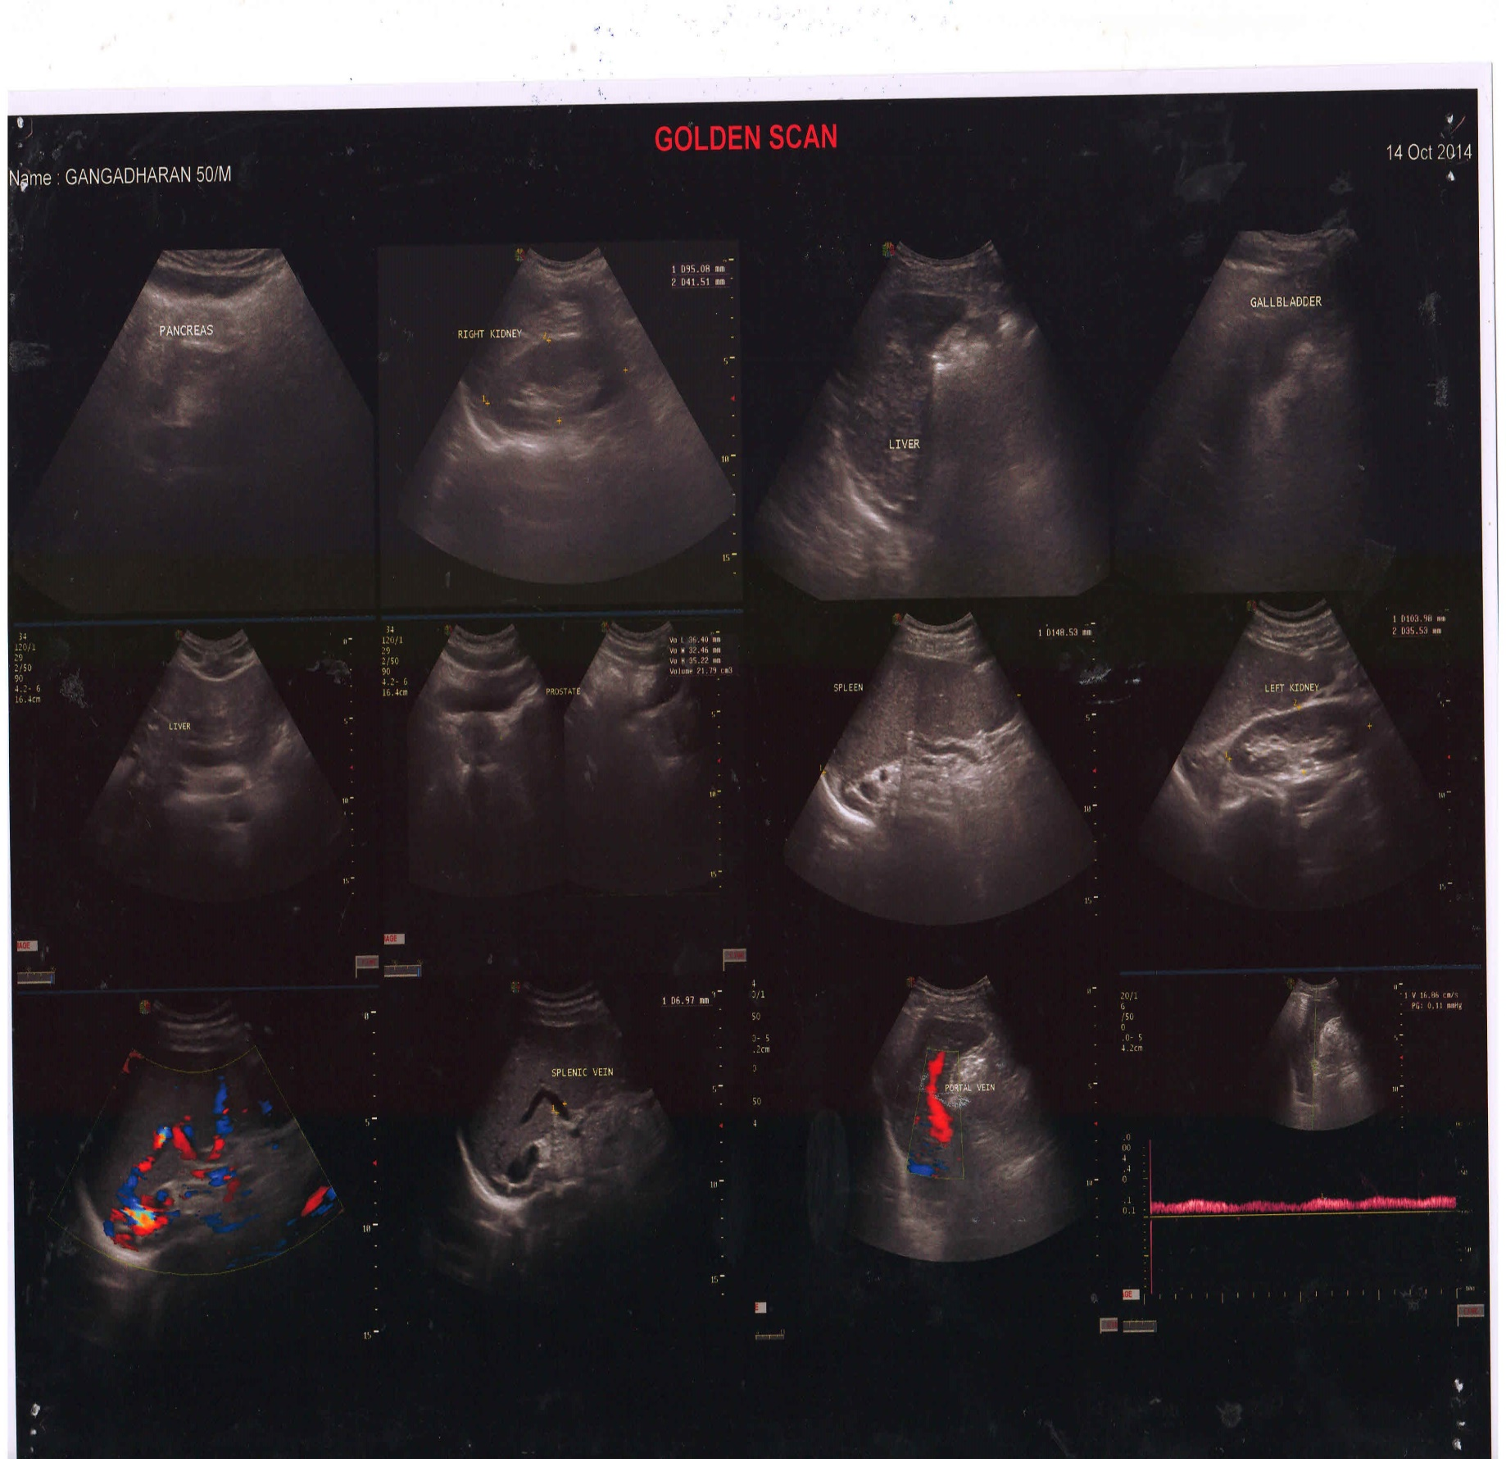

Slide 41
What I missed and the hematologist made out
H/O Jaundice twice
Mild splenomegaly

Slide 42
Portopulmonary hypertension
~ 2% of PoH – hepatic or extrahepatic
PH manifests 2-15 yrs after dx of PoH
SVR is low and C.O is high
OAC at suboptimal doses
All PH specific therapies help
Prognosis is poor – 5 yr survival 40 ~ 64%
BB & TIPS not tolerated

Slide 43
7. A middle aged male Syncope, DOE & Hemoptysis
48 yo male presented with an episode of effort syncope 3 d ago
He had DOE class III 6 months ago, treated as new onset asthma
CXR revealed normal lungs and normal CTR
He felt better with bronchodilataors, but remained in class II
For the last 1 month he has class III Dyspnea again
He had hemoptysis 2 weeks ago, treated with antibiotics
O/E Acyanotic, Varicose veins left leg ; P 88/mt, Regular,
BP 110/88 mm Hg. JVP 3cm, ↑ a, Loud P2, 2/6 ESM ULSB
ECG: RAD, No chamber hypertrophy. CXR: CTR 55%, ↑ MPA
ECHO: Severe Unexplained PH, Mild TR / PG 76 mm Hg, RV Dys

Slide 44
What could have prompted
me to do PA angio ?

Slide 45
Age of presentation – a decade older
H/O DVT or Pulmonary Embolism
Intermittent worsening & improvement
Cough, Pleuritic pain & Hemoptysis
Varicose veins – cause & effect
Bruit over the lung fields (30%)

Slide 46
Is there a way of suspecting CTPH from echo ?

Slide 47
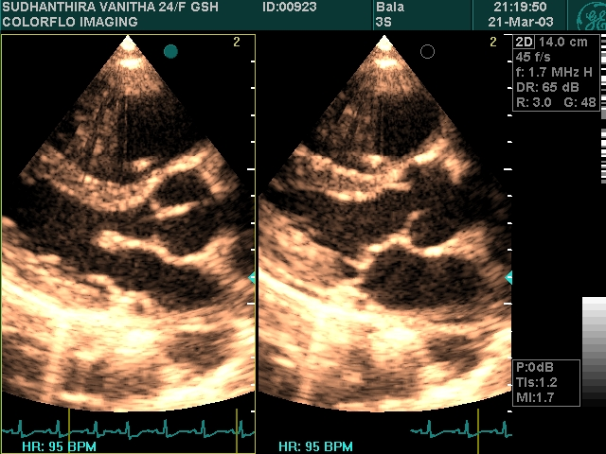
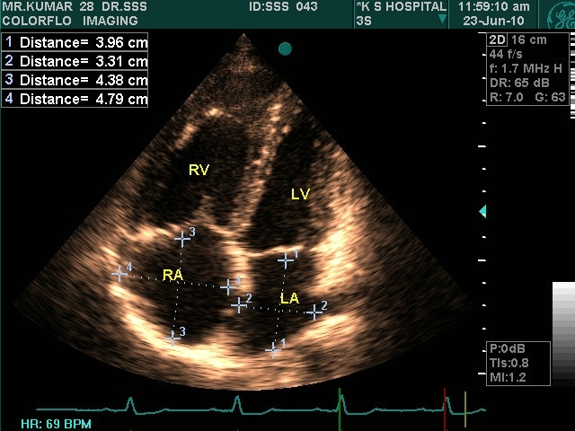
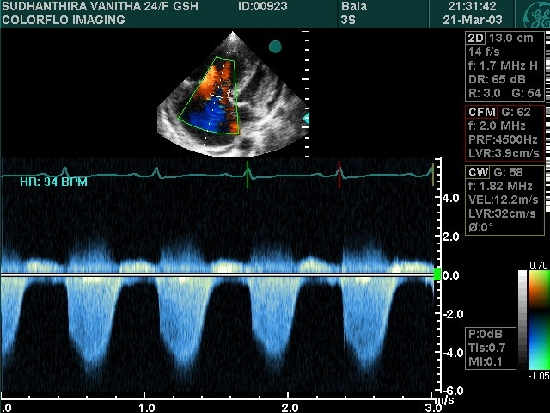
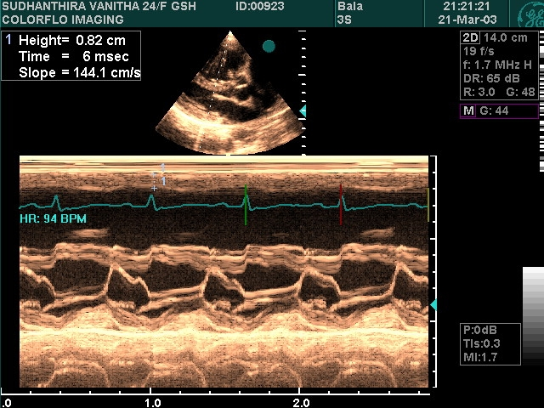
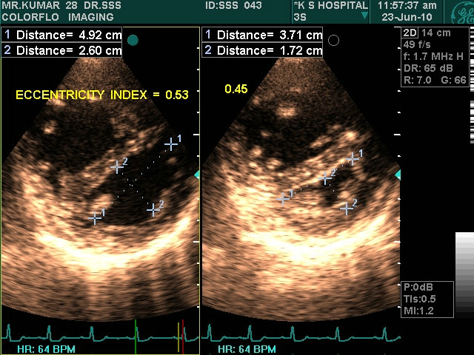
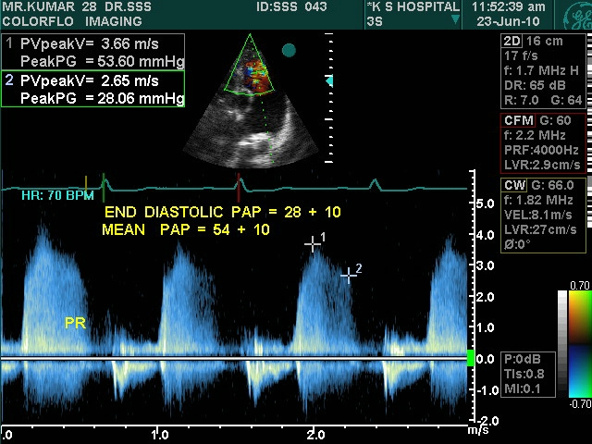
ECHOCARDIOGRAPHY

Slide 48
> 0.77
> 1.35
Y Nakayama, JACC 1998; 31:1367

Slide 49
Augmentation Index =
27.4% ± 15.2% ~ - 25.1% ± 26.9%
97 ± 20 ms ~ 210 ± 49 ms
Y Nakayama JACC 2001;38:214

Slide 50
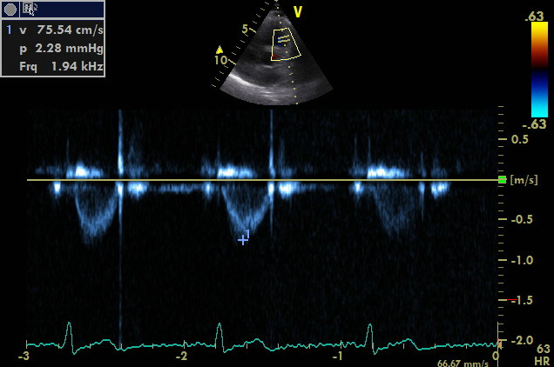
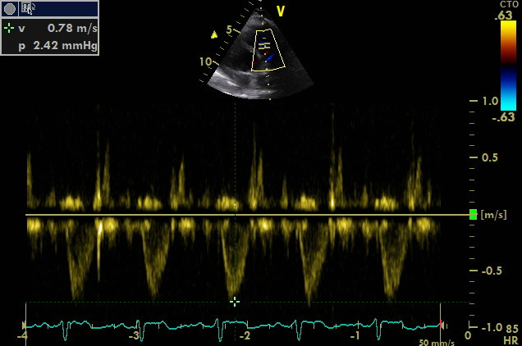
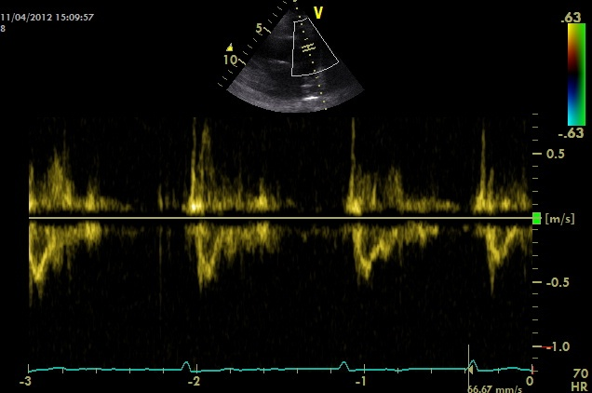
Pulmonary Velocity Profile
Type 1 Type 2 Type 3

Slide 51
M Hardziyenka, EHJ 2007;28: 842

Slide 52
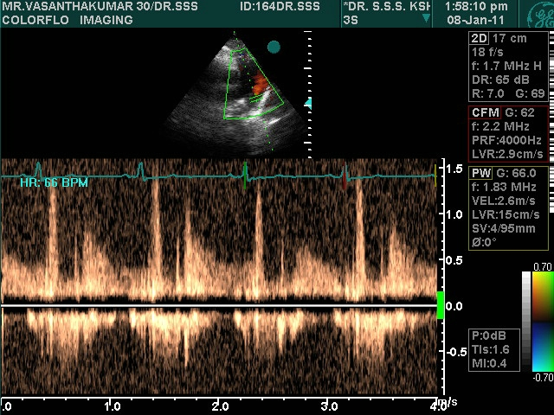

Slide 53
An optometrist with PH of 26 yrs duration
26 y.o. F, presented with DOE class III for 6 m
Heart murmur detected in neonatal life
Echo revealed right heart overload with high pressure TR
She grew up with delayed milestones & had many CV consults & Echoes done periodically
Clas II > III dyspnea with added fatigue
Heart Lung transplant was offered finally

Slide 54
Physical examination
Tall asthenic build, sparse subcutaneous fat
Stretchable skin, few striae
Comfortable at rest, Acyanotic, No clubbing
JVP normal, S1 N; S2 in PA loud, 3/6 harsh ESM along RSB, LSB & Infraclavicular regions, interscapular regions
ECG: RAD & RVH
ECHO: RAE, RVE, RVH, Dilataed MPA, Mild TR with PG of 76 mm Hg.

Slide 55
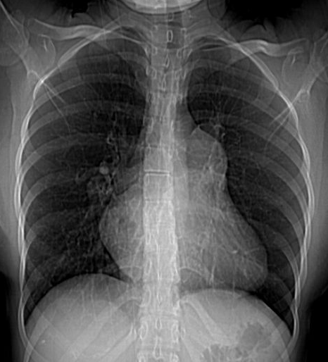
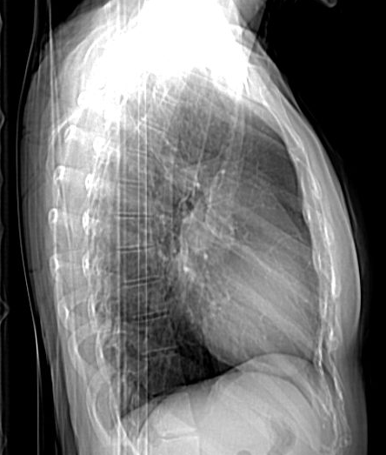

Slide 56
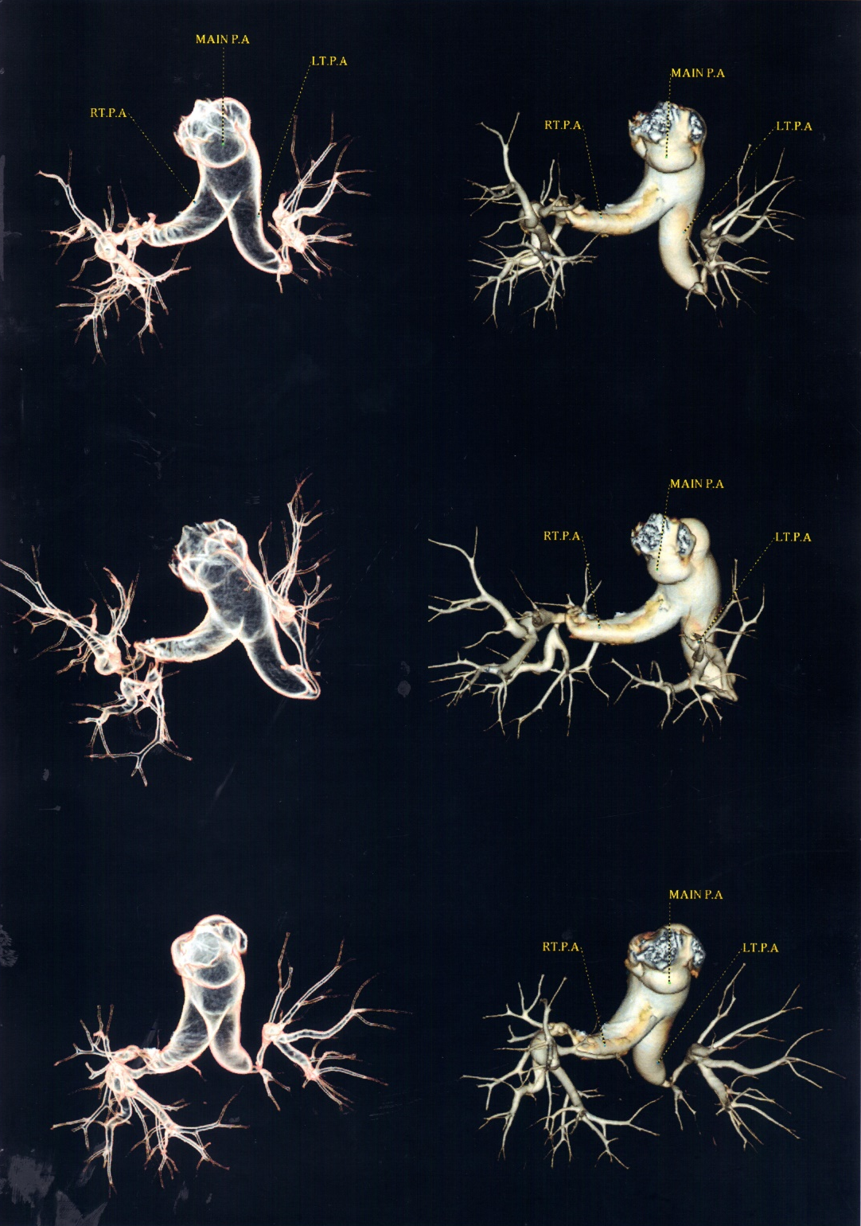
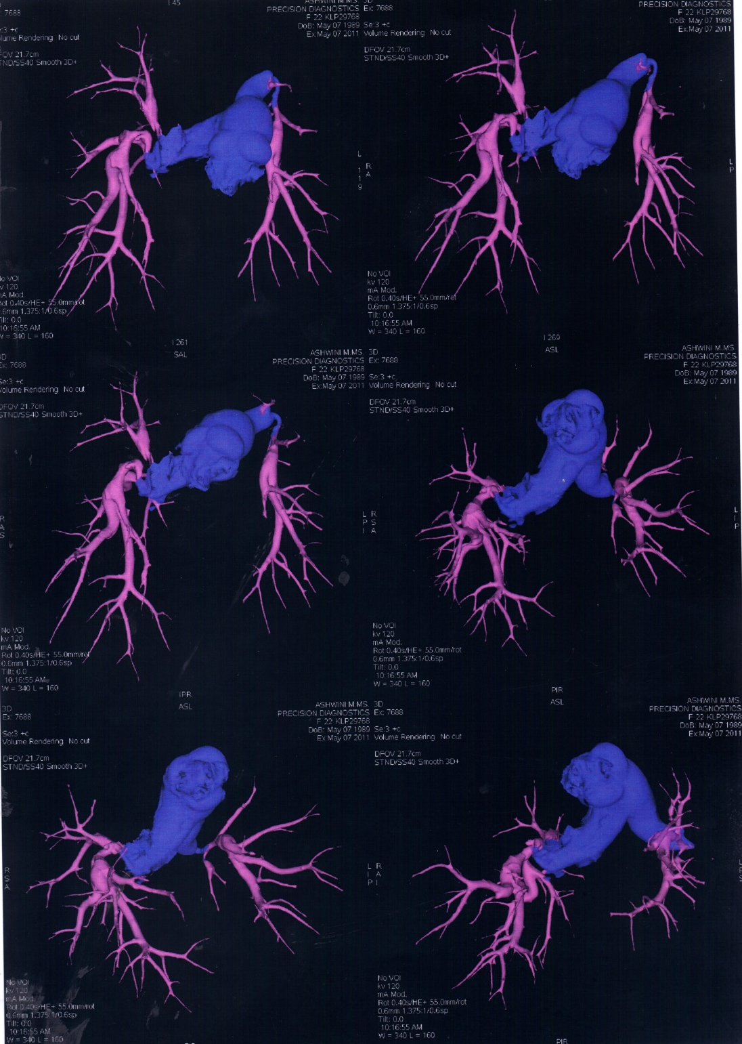

Slide 57
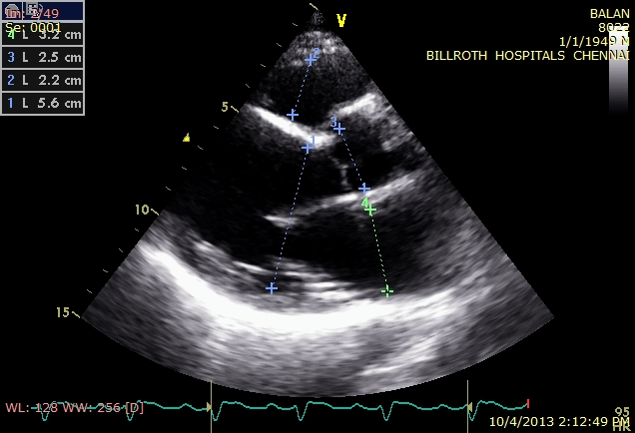
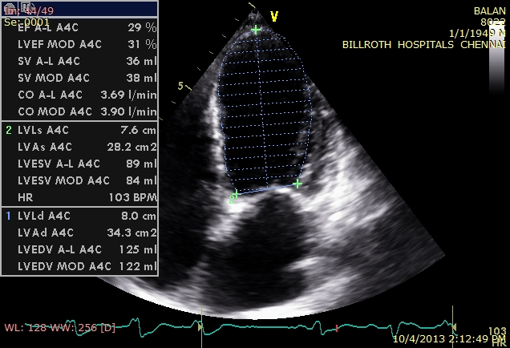
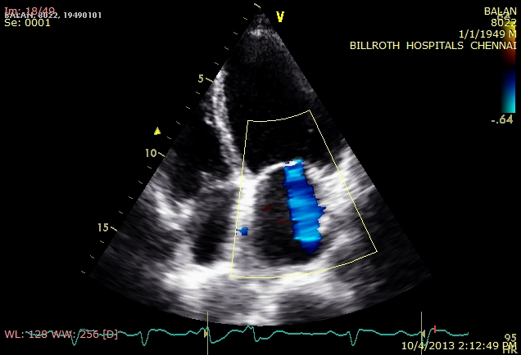
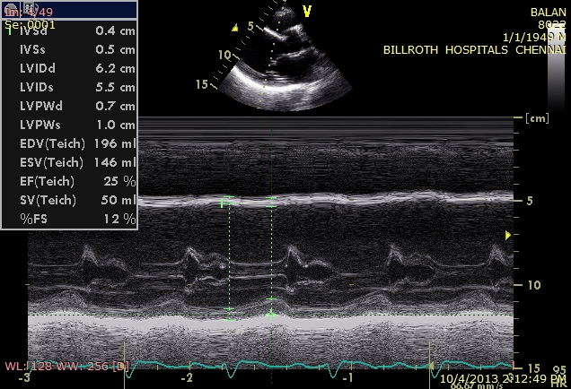
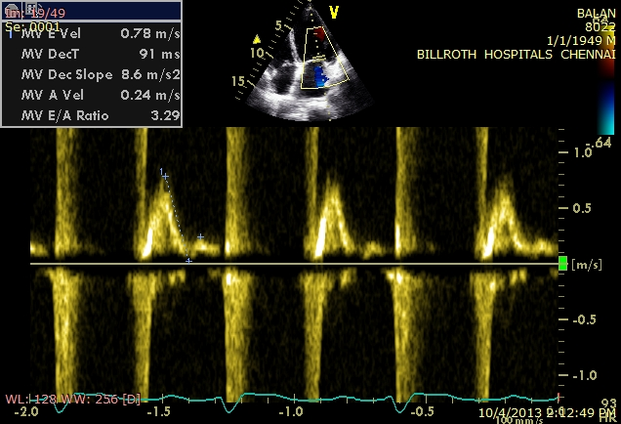
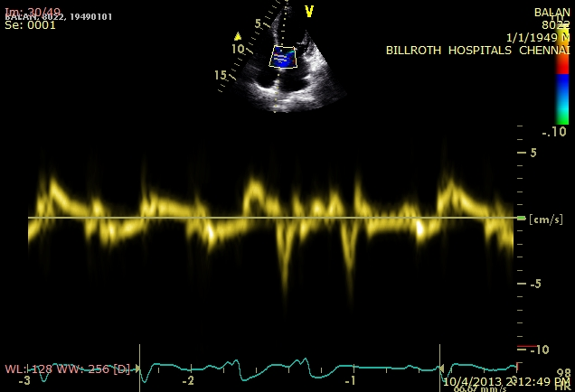
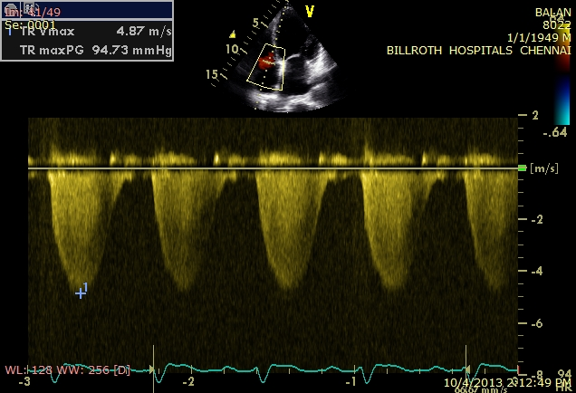
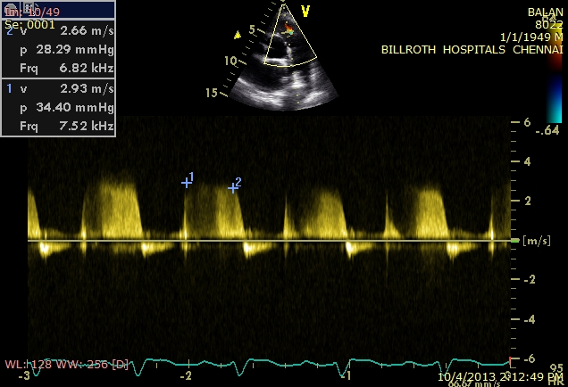

Slide 58
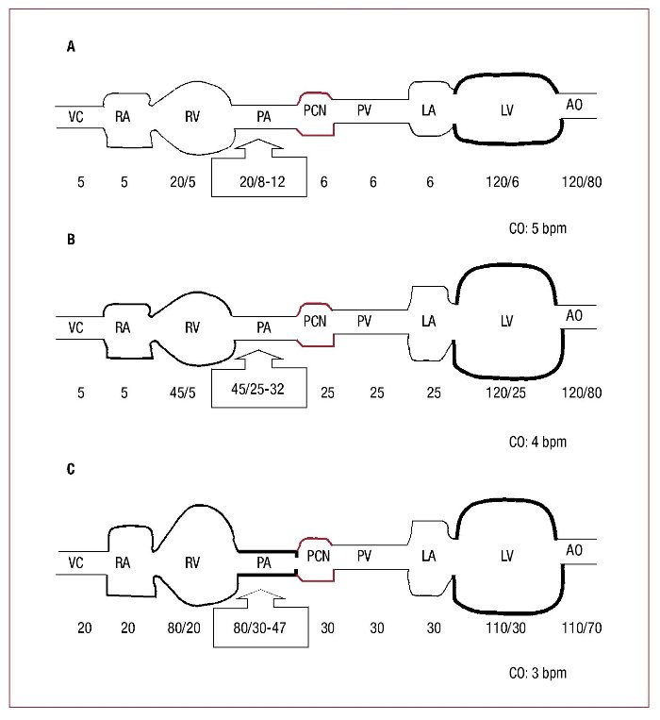
TPG 6±2 mmHg
PVR 0.9 ±0.4 WU
Normal
TPG 6±2 mmHg
PVR 0.9 ±0.4 WU
Passive
TPG > 12 mm Hg
PVR > 2.5 WU
Reactive

Slide 59
Diastolic dysfunction the major determinant of PH in HF patients
E/E’ of > 15 with a MV DT of < 150 ms is highly predictive of PH, irrespective of EF
Left atrial size
Mitral regurgitation
Atrial Fibrillation
Comorbid: Age,Obesity,CKD,Anemia,OSA

Slide 60
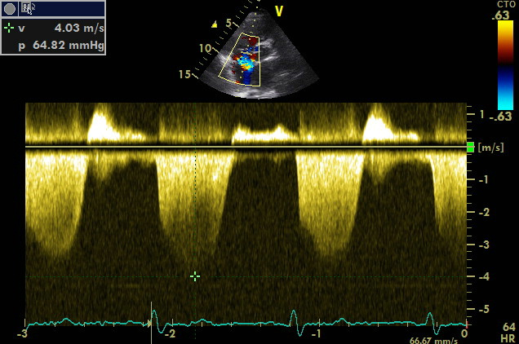
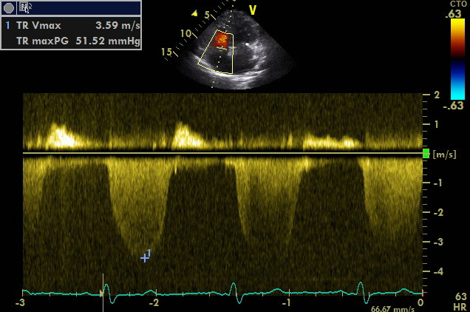
After
Sildenafil
50 mg tid
After
Sildenafil 50 mg tid
and
Ambrisentan 5 mg od

Slide 61
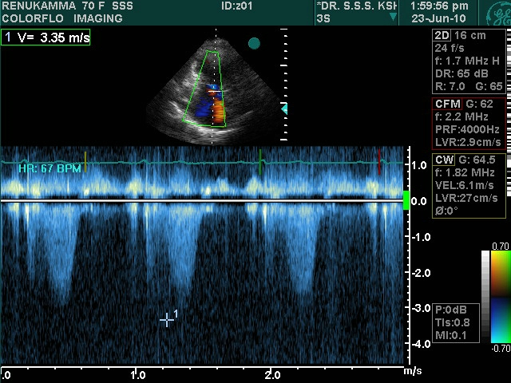

Slide 62
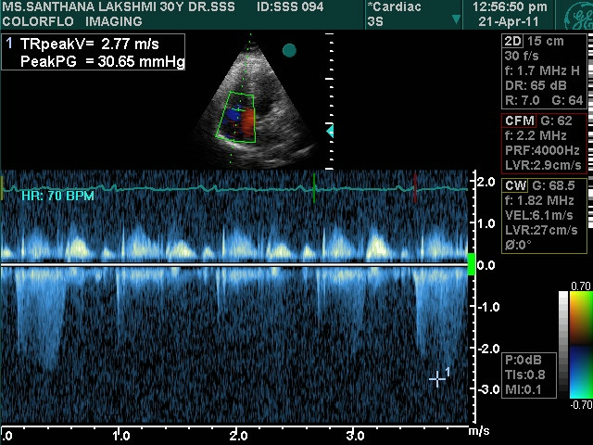

Slide 63
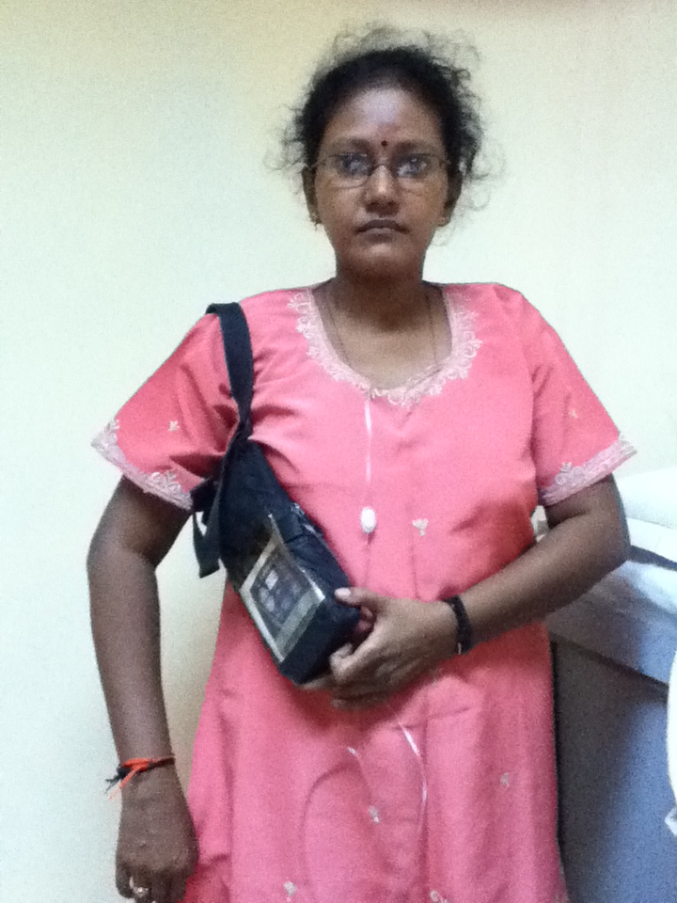
Ms SL 30/F
Class I WHO
6MWD = 420 metres
JVP N; S2 normal;
No murmur.

Slide 64
Study of Intravenous Remodulin in Patients in India With Pulmonary Arterial Hypertension (TRUST-1)
Enrolled in July 2005
Class III – DOE and presyncope on effort
2 of her elder sisters died of PAH
Elevated JVP, PSH, Loud P2 and 2/6 TR murmur
ECG: RAD, RVH
CXR: CTR of 60% Arterial PAH
RHC – PAP = 98/46 m 63 mmHg

Slide 65

TK 38/M
Class II WHO
Normal JVP
Loud P2
3/6 PR murmur
6MWD = 385 m

Slide 66
PULMONARY HYPERTENSION mPAP ≥ 25 mm Hg
PAWP < 15 mmHg Pre Capillary PH
PAWP > 15 mmHg Post Capillary PH
1.Pulmonary Arterial
Hypertension
TPG > 12 mm Hg
PVR > 3 WU Reactive / Mixed
out of proportion PH
TPG < 12 mm Hg
PVR < 3 WU
PVH / Passive PH
Proportional PH
3.PH due to lung
disease / Hypoxia
4.Thrombo embolic PH
HF
R
HF
R
5.PH of multifactorial
cause
TPG < 12 mm Hg
PVR < 3 WU
TPG > 12 mm Hg
PVR > 3 WU
Reversible or
Responsive PH
Fixed or
Irreversible or Unresponsive PH
Reversible or
Responsive PH

Slide 67





Slide 68
PAH > DD DD > PH
Age (decade) 3 – 4 7 - 8
Symptoms DOE, Syncope PND,Orthopnea
Comorbid --- CKD, Anemia, AF
OSA, Obesity
ECG RAE,RAD,RVH LAE, LVH, AF
ECHO RAE,RVH,TR LAE,LVH, DD
‘D’ shaped LV
PA PRESSURE ~ 80 ~ 50 mmHg
PAWP < 15 > 15 mm Hg

Slide 69
Partitioning of PVR
Rup% = 100 (mPpa – Poccl)
(mPpa – Ppao)

Slide 70


